Slide 1
How to use LMS

Slide 2
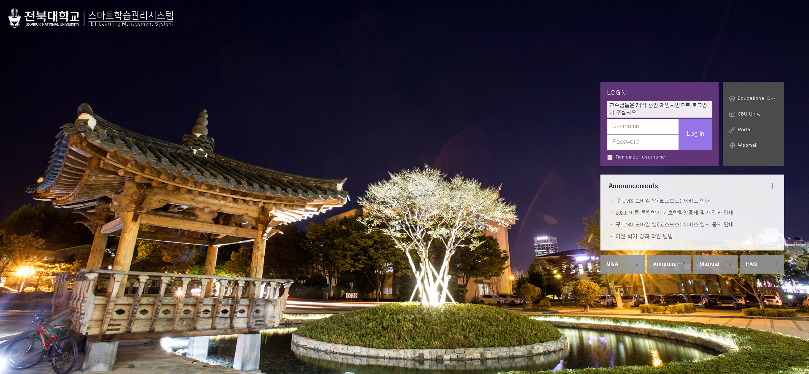
old LMS
If you log in, you can see all your lecture.

Slide 3
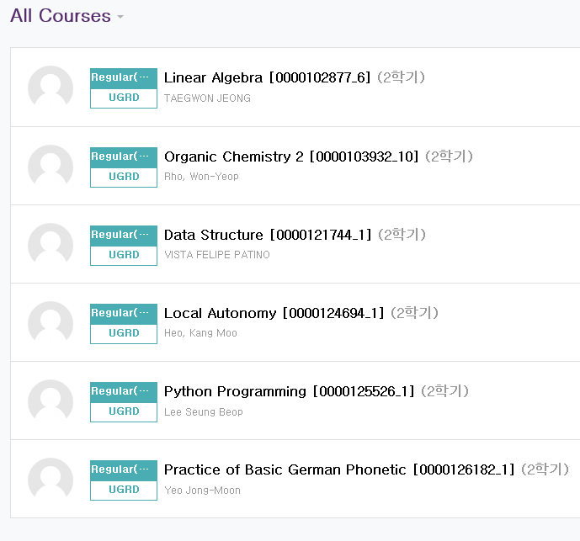
How to get in touch with a professor
Click on the class of the professor you want to contact.

Slide 4
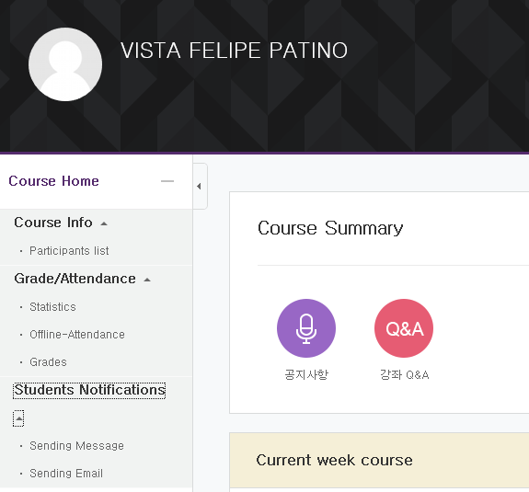
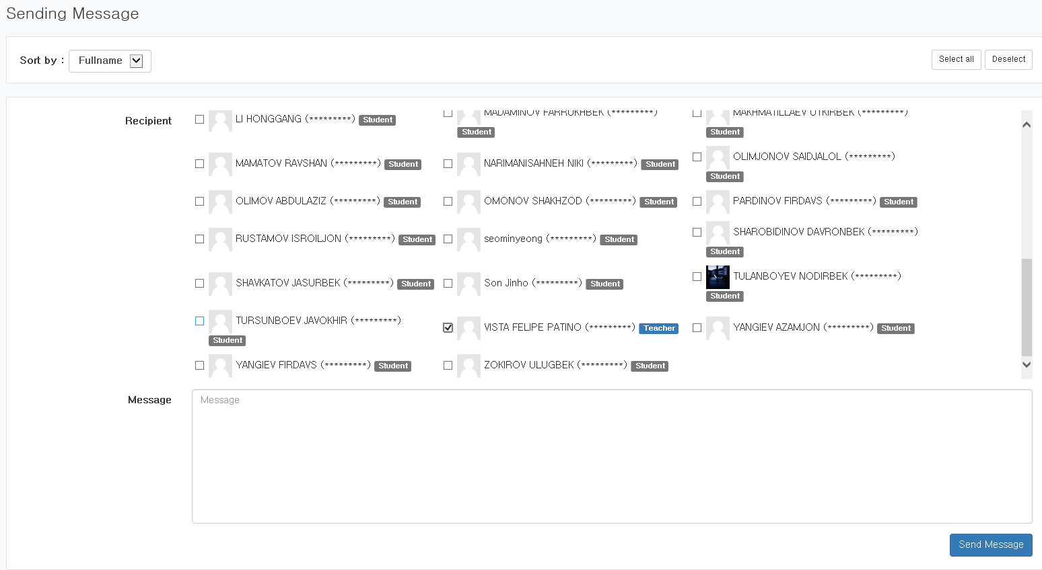
Sending message or sending email

Slide 5
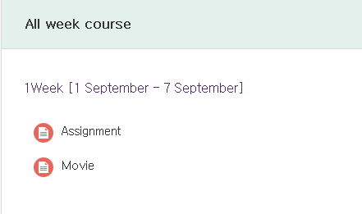
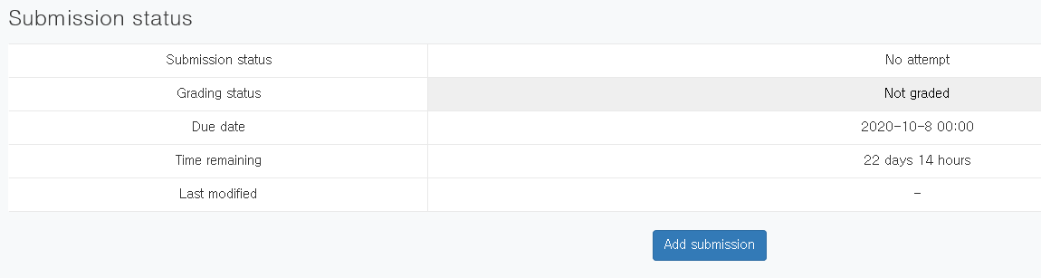
How to submit a homework
1. click on the course you want to submit your assignment to.
2.
Click on the lecture you are supposed to submit
your homework.
3.

Slide 6
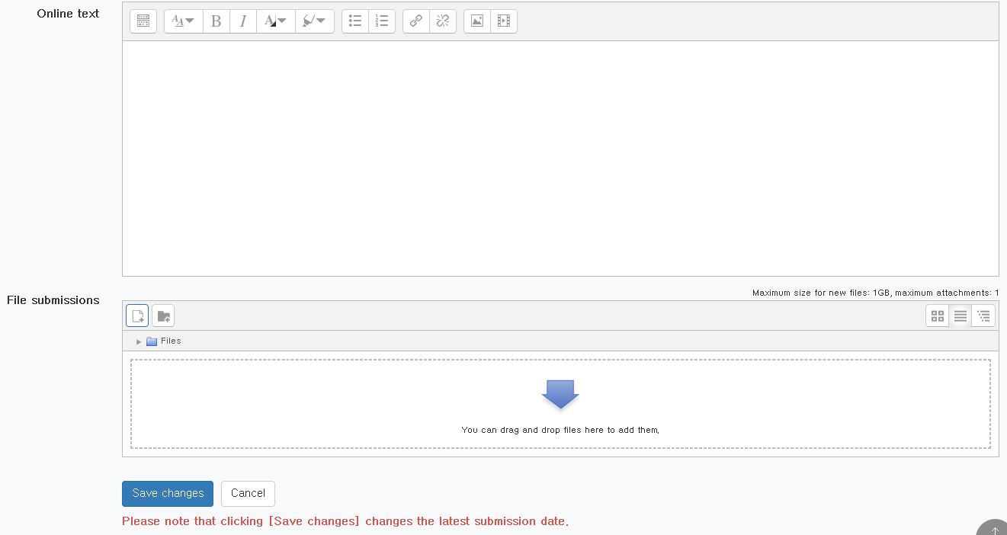
4.

Slide 7
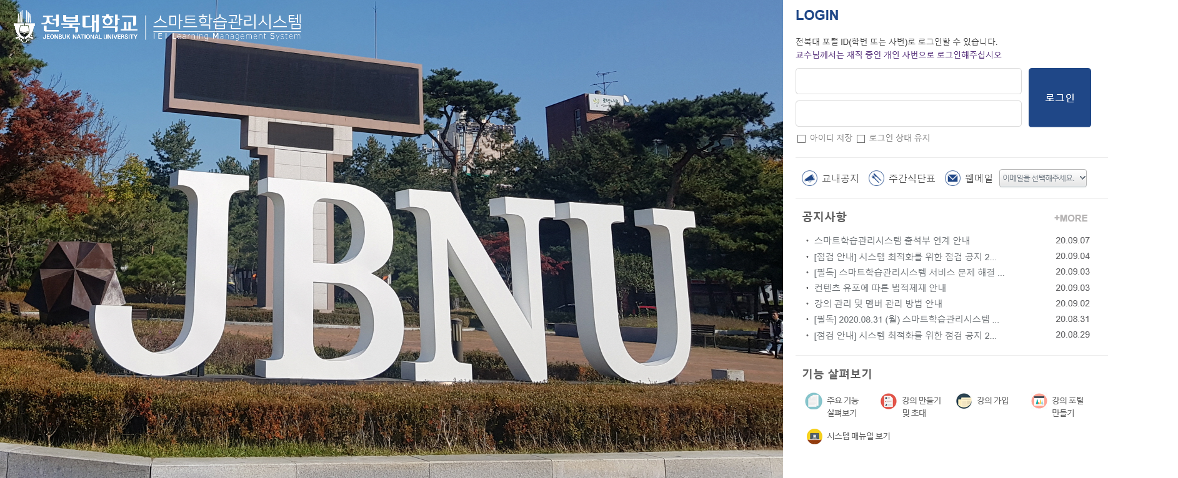
LMS
If you log in, you can see all your lecture.

Slide 8
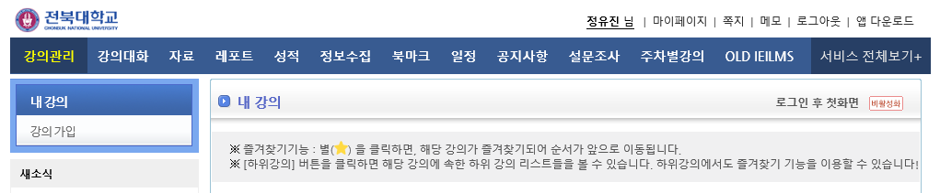
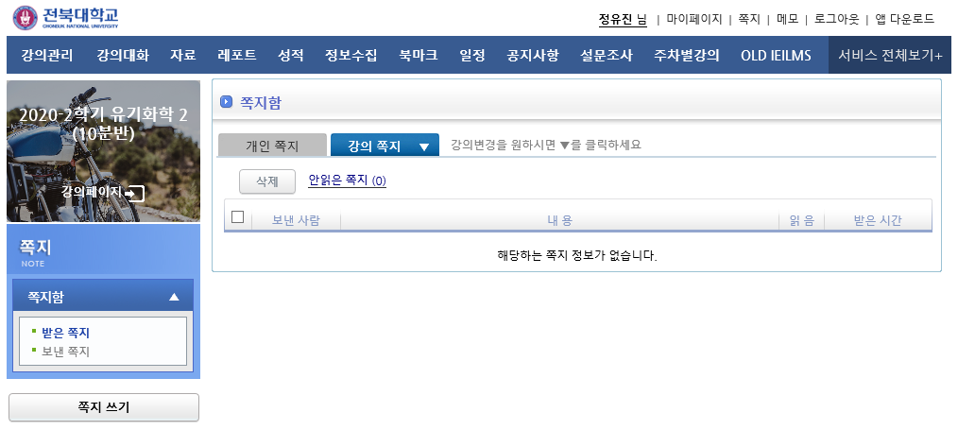
How to get in touch with a professor message
writing a message

Slide 9
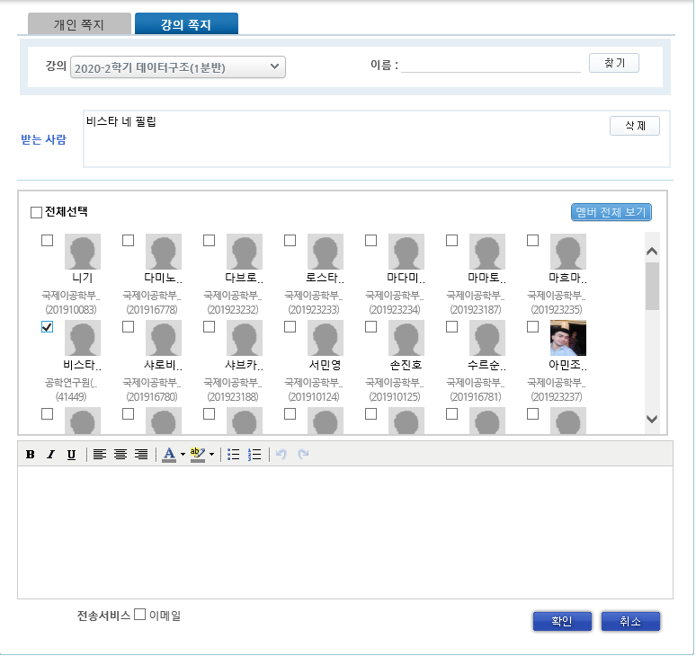
lecture message
1. select a course to which I will send a message to
2. select the person (professor)
who I will send the message to
3. write a message to send
4. click after writing message

Slide 10
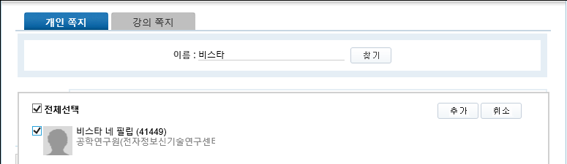
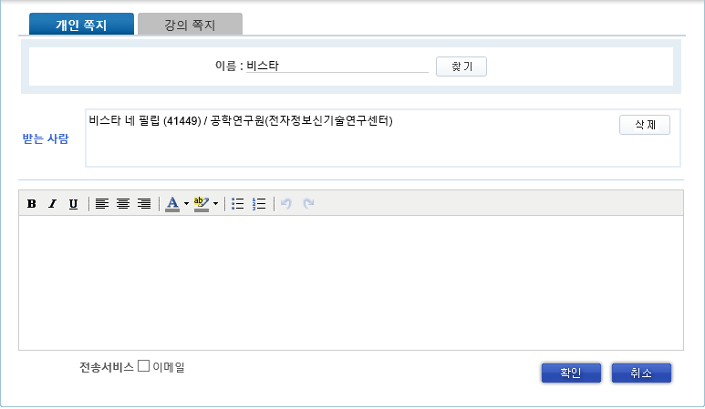
personal message
2. write the name and then click
1. write the name of the person I want to send the message to
4. select and then click
3. choose who I want to send the message to
5. write a message to send
6. click after writing message

Slide 11
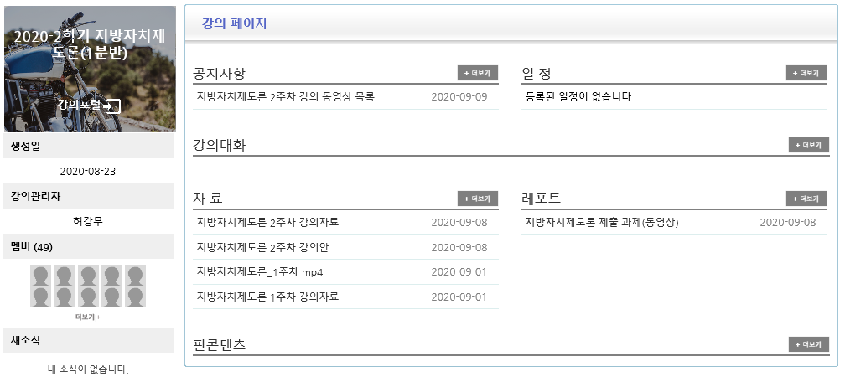
notice schedule
lecture conversation
lecture materials report

